Slide 1
Probabilistic Model

Slide 2
The Boolean and vector space approaches make implicit assumptions about relevance and text representation
The Probability Ranking Principle, as originally stated, is as follows:
If a reference retrieval system’s1 response to each request is a ranking of the documents in the collection in order of decreasing probability of relevance to the user who submitted the request, where the probabilities are estimated as accurately as possible on the basis of whatever data have been made available to the system for this purpose, the overall effectiveness of the system to its user will be the best that is obtainable on the basis of those data.

Slide 3
Unfortunately, the Probability Ranking Principle doesn’t tell us how to calculate or estimate the probability of relevance.
we start with a simple probabilistic model based on treating information retrieval as a classification problem.

Slide 4
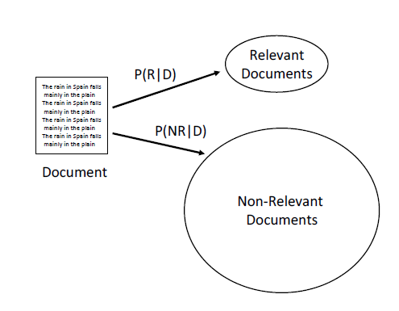
Probabilistic Model:Information Retrieval as Classification

Slide 5
In any retrieval model that assumes relevance is binary, there will be two sets of documents, the relevant documents and the non-relevant documents, for each query.
That is, the system should classify the document as relevant or non-relevant,and retrieve it if it is relevant.

Slide 6
let’s focus on P(R|D)…let’s focus on
P(R|D)-🡪P(D|R)
if we had information about how often specific words occurred in the relevant set, then, given a new document, it would be relatively straightforward to calculate how likely it would be to see the combination of words in the document occurring in the relevant set.

Slide 7
Let’s assume that the probability
of the word “president” in the relevant set is 0.02, and the probability of “lincoln” is 0.03. If a new document contains the words “president” and “lincoln”,
we could say that the probability of observing that combination of words in the relevant set is 0.02 × 0.03 = 0.0006, assuming that the two words occur independently.

Slide 8

how does calculating P(D|R) get us to the probability of relevance?
By Bayes’ Rule:
where P(R) is the a priori probability of relevance (in other words, how likely any document is to be relevant), and P(D) acts as a normalizing constant.

Slide 9

Given this, we can express our decision rule in the following way: classify a document as
relevant if P(D|R)P(R) > P(D|NR)P(NR).
This is the same as classifying a document as relevant if:
The left-hand side of this equation is known as the likelihood ratio.

Slide 10
If we use the likelihood ratio as a score, the highly ranked documents will be those that have a high likelihood of belonging to the relevant set.

